Slide 1

Movie Recommender System
Project By:-
1.Kapil Kumar Sharma (17135048)
2.Vaibhav Mehta(17134024)
3.Sachin Bhuria (17085065)
4.Shrikant Kumar (17135082)

Slide 2
Content Based Recommender
Suggests movies that are most similar to the movie the user liked
Compares movies on the basis of the overview and the tagline

Slide 3
Collaborative Recommender
Based on the idea that users similar to a me can be used to predict how much I will like a particular product or service those users have used/experienced but I have not.
Used the Surprise Library to implement the SVD algorithm
SVD minimises the RMSE error which gives great recommendations

Slide 4
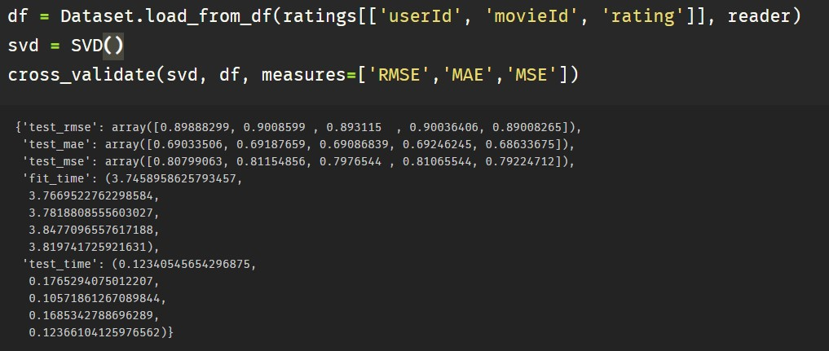
Code snippet & Output
The RMSE is 0.89 here which is good enough

Slide 5
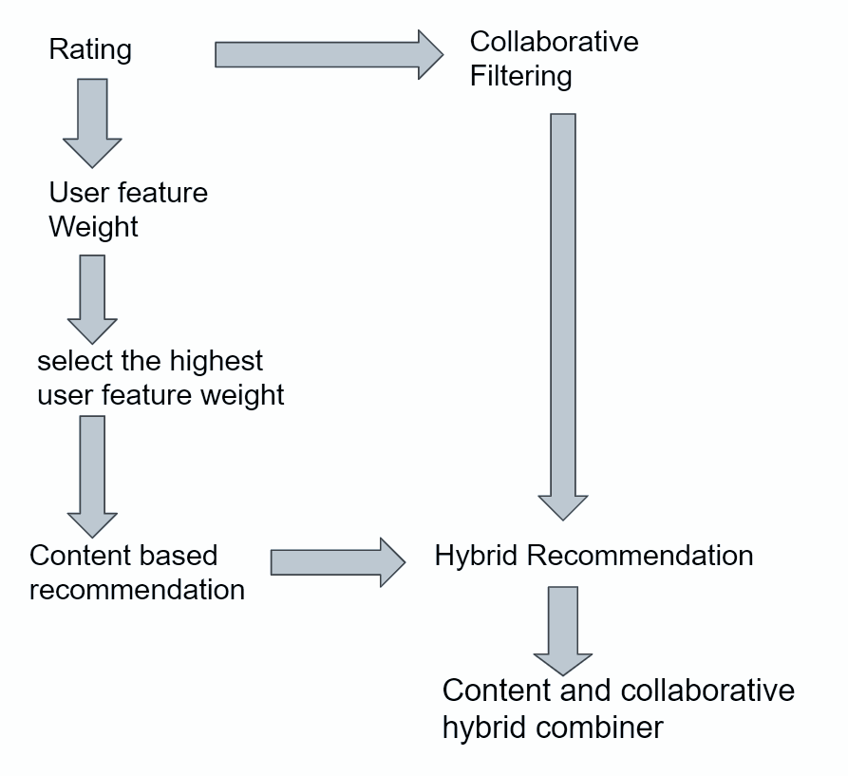
The Final Recommender

Slide 6
Hybrid Model
A simple hybrid recommender that brings together techniques implemented in the content based and collaborative filter based engines.
Input: User ID and the Title of a Movie
Output: Similar movies sorted on the basis of expected ratings by that particular user.

Slide 7
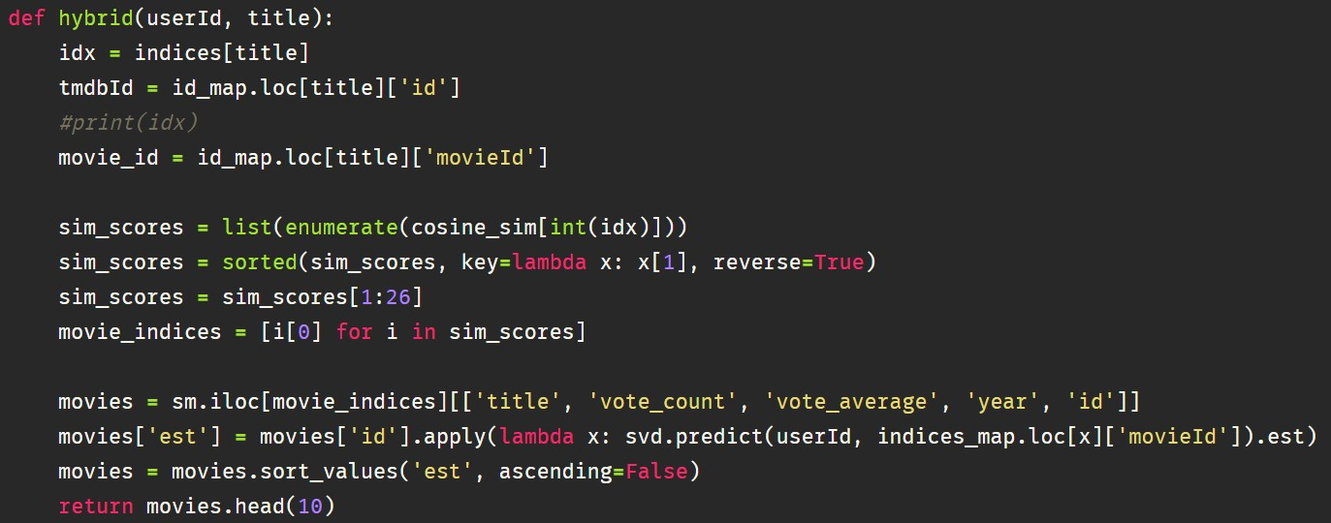
Code Snippet

Slide 8
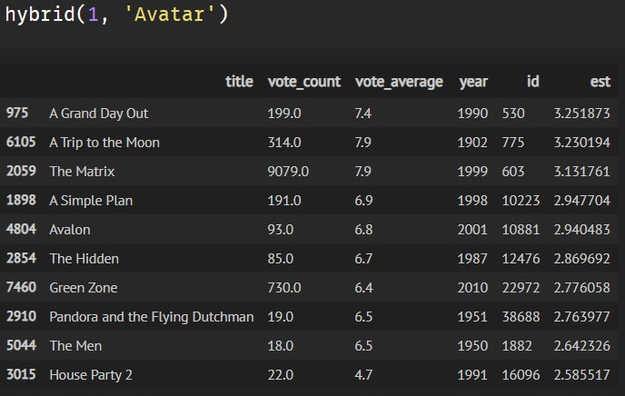
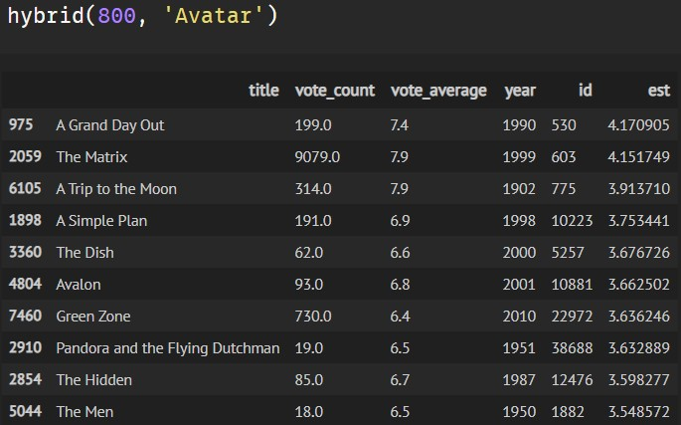
Output

Slide 9
Conclusion-
Built different type of recommender systems-
Simple Recommender: The IMDB Weighted Rating System was used to calculate ratings on which the sorting was finally performed.
Content Based Recommender: Built two content based engines; one that took movie overview and taglines as input and the other which took metadata such as cast, crew, genre and keywords to come up with predictions.
Collaborative Filtering: Used the powerful Surprise Library to build a collaborative filter based on single value decomposition.
Hybrid Engine: Brought together ideas from content and collaborative filtering to give movie suggestions to a particular user based on the estimated ratings that had internally calculated for that user.

